Slide 1
Image Super resolution
CSCI 5922 – Neural Networks and Deep Learning Project
Kaushik Metha

Slide 2
Introduction
Want to Enhance your image quality?
Image super resolution to the rescue
What is image super resolution?

Slide 3
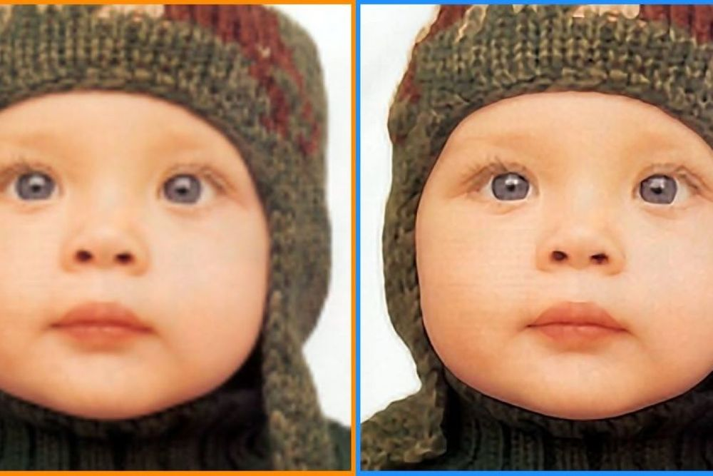
This is super resolution!
Image credits: https://blog.paperspace.com/image-super-resolution/

Slide 4
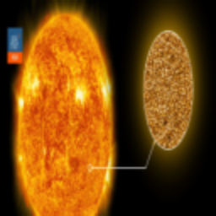

Dataset
Collected from Kaggle (Link)
Images from various domains
685 train and 170 test images (Low-res and high-res pair)
Image credits:
https://www.kaggle.com/datasets/adityachandrasekhar/image-super-resolution
Low resolution image
High resolution image

Slide 5
Data Preprocessing and preparation
Resize to 256 x 256 x 3
Normalize: 0 to 1
split into train – validation – test
Dataset (Link)

Slide 6
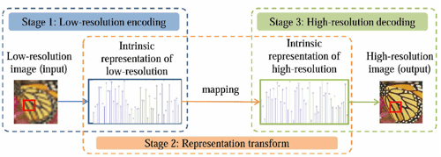
Model architecture
Autoencoder approach
Encoder
Feature extraction
Downsampling
compression
Decoder
Upsampling
Feature reconstruction
Output generation
Skip connections
Architecture (LINK)
Image credits: https://www.semanticscholar.org/paper/Coupled-Deep-Autoencoder-for-Single-Image-Zeng-Yu/cbec1de269cb8e4e59d452b61e4b5b7add86e7cc

Slide 7
Results
Parameters:
Epochs: 1000
Batch size: 128
Optimizer: adam
Loss: mean squared error
Metrics: Peak signal-to-noise ratio and structural similarity index
Validation split: 20%

Slide 8
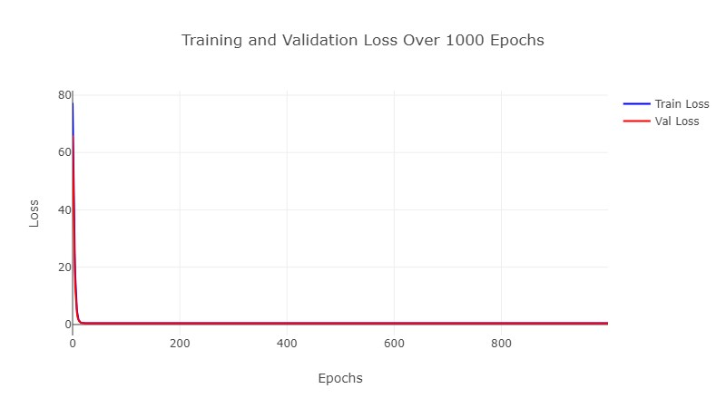
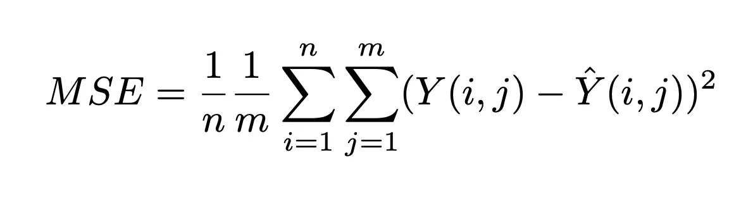
Loss – mean squared error
Image credits: https://medium.com/analytics-vidhya/loss-functions-for-image-super-resolution-sisr-8a65644fbd85

Slide 9
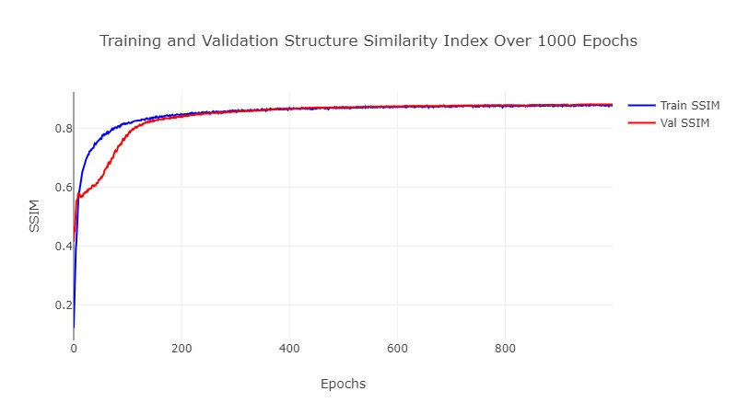
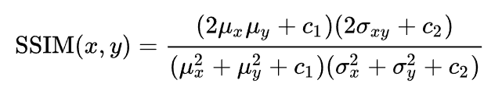
Structural Similarity Index
Image credits: https://en.wikipedia.org/wiki/Structural_similarity

Slide 10
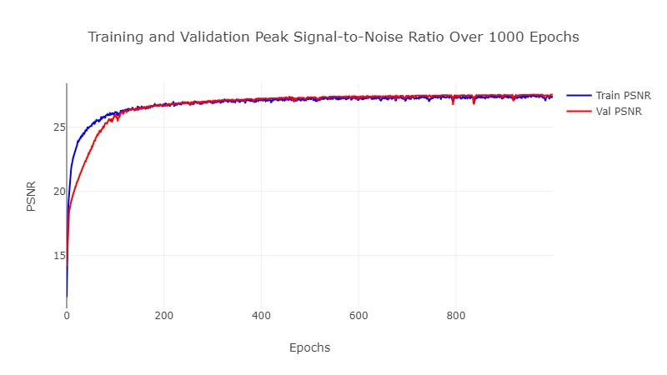

Peak signal-to-noise ratio
Image credits: https://www.ni.com/en-in/shop/data-acquisition-and-control/add-ons-for-data-acquisition-and-control/what-is-vision-development-module/peak-signal-to-noise-ratio-as-an-image-quality-metric.html

Slide 11
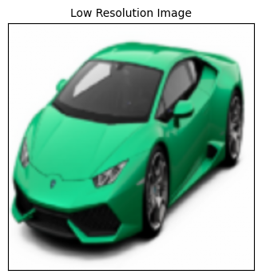

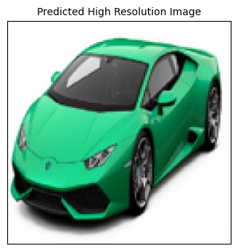
Model Performance
 | MSE | PSNR | SSIM
Training | 0.4589 | 27.3409dB | 0.8784
Validation | 0.4593 | 27.5442dB | 0.8816
Testing | 0.4594 | 27.3148dB | 0.8767

Slide 12
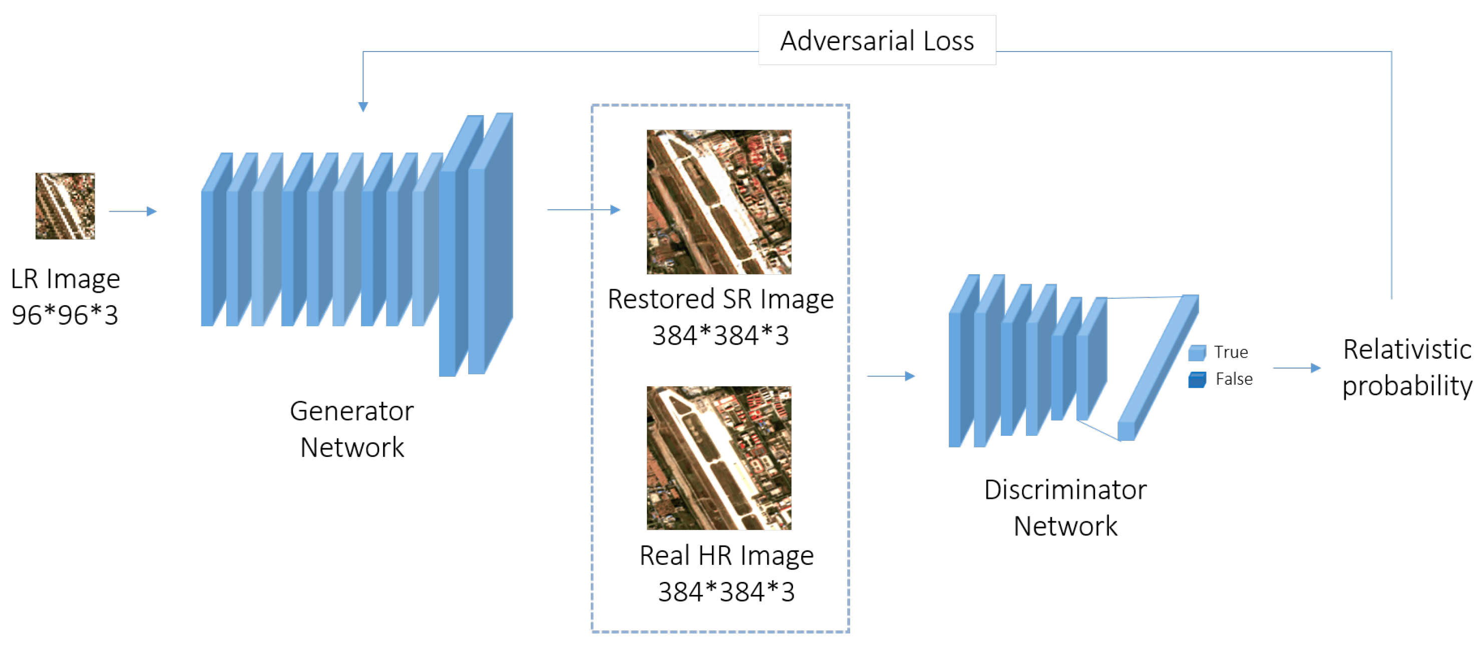
Conclusion and future work
Decent model performance
Why psnr and ssim over accuracy?
Using gans
Incorporating different dimensions
Image credits: https://mriquestions.com/super-resolution.html

Slide 13
THANK YOU!

